Slide 1
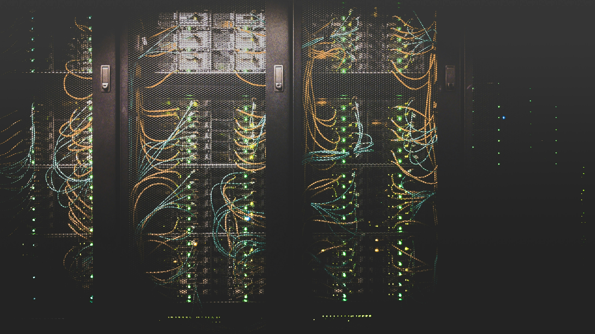

Data Center Heat Reuse in the Food & Beverage Sector
Prepared for Microsoft
Petter Terenius and David Gardiner & Associates
August 2025

Slide 2

Table of Contents
Introduction
Key Takeaways
Methodology & Assumptions
Case Studies
Conclusion

Slide 3
Introduction
01
This analysis explores the business case for Microsoft to capture waste heat from its data centers and supply it to facilities in the Food and Beverage (F&B) sector.
The report lays out five hypothetical but realistic use cases from across Europe, using actual Microsoft data centers and potential industrial off-takers.
These diverse cases show how heat reuse might work and serve as templates for future projects. They should not be treated as real business plans, but they demonstrate that reusing heat from Microsoft’s data centers in Europe for low-temperature industrial processes is a real and substantial opportunity.

Slide 4
Key Takeaways
02

Slide 5
Key Takeaways
Key Takeaways
Most large F&B manufacturing sites have thermal energy needs around or below 8-10 MW.
CAPEX for heat reuse projects is ~€9M, primarily driven by heat pump costs. Situations requiring only one heat pump would see reduced CAPEX costs.
Piping and trenching is affordable and can deliver heat long distances (even 30 km) with manageable heat losses.

Slide 6
Key Takeaways
Key Takeaways (continued)
Depending on the local energy costs, carbon taxes, and subsidies, payback periods for heat reuse projects can reach as low as two to five years.
Feasibility of projects will depend on details of off-taker facilities, including existing infrastructure (i.e. heat pumps) and specific thermal energy demands.
These can only be determined by contacting potential off-takers.
Opportunities to reuse Microsoft data center heat in F&B factories exist across Europe.

Slide 7
Methodology & Assumptions
03

Slide 8
Methodology
01
General Approach - Limitations
The use cases presented in the report are intended to serve as examples to illustrate the overall opportunity, rather than specific recommendations.
This report acts as a pre-feasibility study and does not contain details of potential off-takers’ facilities and processes. We do not know what portion of an off-taker's existing infrastructure, such as heat pumps, could be used for a heat reuse project.
To move forward, Microsoft would need to inquire with off-takers directly to learn about their exiting equipment, thermal energy requirements, energy costs, and financial context.

Slide 9
Methodology
Off-taker Identification & Selection Methodology
Selecting potential off-takers for each case began with a list of F&B facilities within 3 km of Microsoft data centers (identified by the Proximity Analysis).
Since each manufacturing facility’s thermal energy needs are not known, the analysis estimated sites’ thermal demands based on their F&B subsector and the size of facility, measured by its number of employees.
01
Manufacturing sites near Microsoft data centers with the greatest estimated thermal energy needs
Facility | Distance to data center (km) | # of Employees | NACE Activity Name | Thermal Energy Needs (ranking)
RAGUS SUGARS (MANUFACTURING) LIMITED | 1.034 | 48 | Manufacture of sugar | 1
BEAM SUNTORY SPAIN SL. | 1.948 | 244 | Distilling, rectifying and blending of spirits | 2
R & A Bailey & Company | 0.481 | 130 | Distilling, rectifying and blending of spirits | 2
Premier Foods Group Ltd, Rogerstone Park Food Factory | 6.086 | 850 | Production of meat and poultry meat products | 3
Wilhelm Brandenburg GmbH & Co. oHG | 1.357 | 750 | Production of meat and poultry meat products | 3

Slide 10
Methodology
01
Off-taker Identification & Selection Methodology
In selecting potential off-takers to explore as options, DGA chose larger facilities with greater heat demand because they are more likely to have around-the-clock processes, as well as flexibility to guarantee that the return water is sufficiently cooled for the data center.
It also targets facilities using heat between 70 and 80°C, such as dairy and meat processing, which can be feasibly produced by data centers.
However, the analysis does not account for specific temperatures required by different industrial or food production processes.

Slide 11
Methodology
Technical System Design & Assumptions
The analysis outlines a hypothetical heat reuse system to understand project needs and help estimate costs.
It describes piping and the off-taker’s heat distribution system but excludes the data center's internal heat exchange room, which is assumed to be a required and unavoidable cost for the data center itself.
A closed-loop thermal system
The system is designed for an available energy load of 1-20 MW, modeling a 5.6 MW transfer of heat from data center to off-taker.
The working fluid is water.
The analysis considers two main temperature scenarios: water leaving the data center at 30°C (traditional compute) or 65°C (AI compute).
Water must return to the data center at least 12°C colder than it left.
Piping & Trenching
HDPE (High-Density Polyethylene) pipes were chosen over stainless steel as they are cheaper, more energy-efficient for transport, and have a lower carbon footprint.
The model uses 160 mm pre-insulated pipes for the forward journey. It leaves the return pipe uninsulated to help lower the water temperature and reduce costs at the data center.

Slide 12
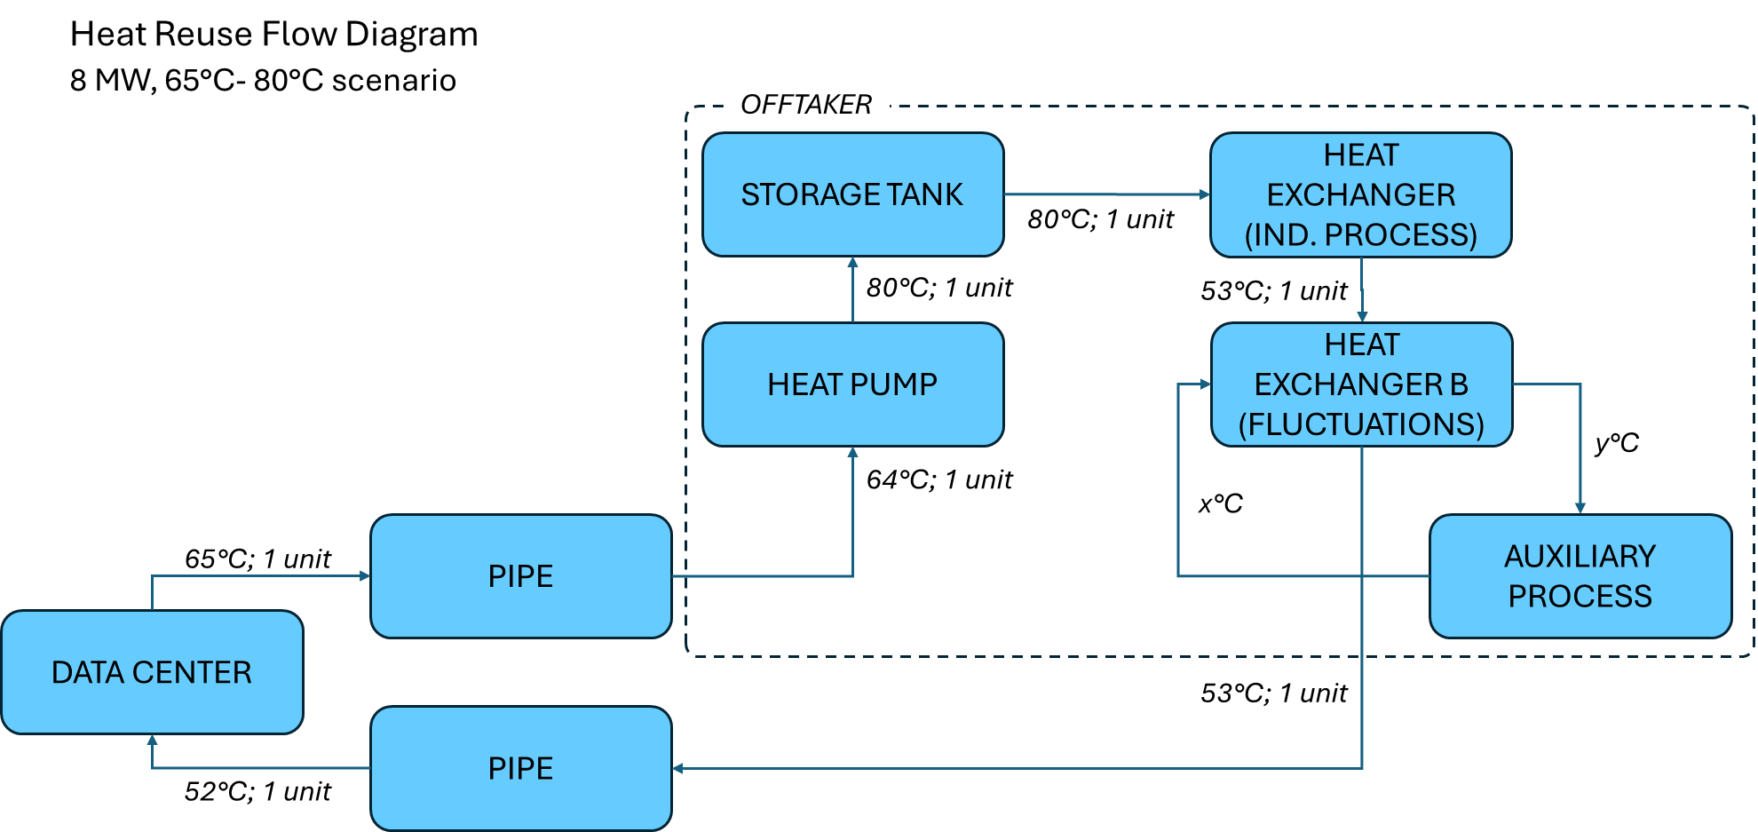
Methodology
System Diagram: AI Compute (65°C ) Scenario
The primary heat pump is assumed to have a Coefficient of Performance (COP) of 3.5.

Slide 13
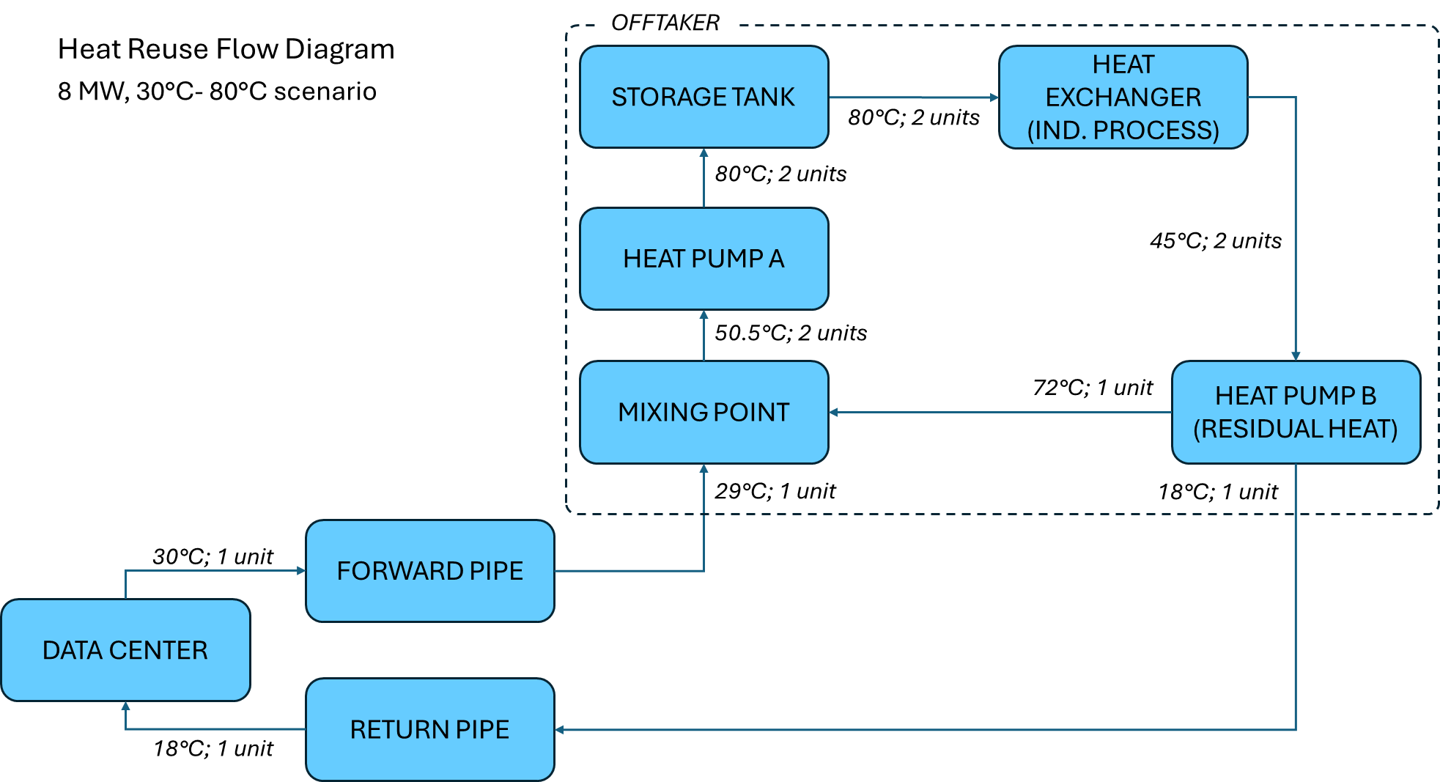
Methodology
System Diagram: Traditional Compute (30°C ) Scenario
For the 30°C scenario, a
dual-heat-pump, closed-loop would efficiently raise the temperature to 80°C while precisely controlling the return temperature.

Slide 14
Methodology
Financial Calculations & Assumptions
Project payback periods will depend on local prices for electricity, natural gas, avoided carbon tax (EU ETS), and other subsidies.
The financial benefit of avoiding carbon emissions is calculated based on the EU ETS, which functions like a market-based carbon tax. The price is assumed to be €73 per ton of CO₂.
A flat cost of €100 per meter is assumed for trenching, installation, and auxiliary parts. Pipe costs are estimated at €45/m (forward) and €20/m (return)
The analysis uses current energy prices:
01
Specific Country Energy Prices Used
Country | Electricity Price (€/MWh) | Natural Gas Price (€/MWh)
Germany | 160 | 80
UK | 122 | 81
Netherlands | 152 | 32
Spain | 98 | 33
Sweden | 52 | 113

Slide 15
Case Studies
03

Slide 16

Case Studies
Germany (Frankfurt)
F&B Facility: Wilhelm Brandenburg GmbH & Co (Meat Processing)
01
Facility Info
Distance to data center: 1.5 km
Data center output temperature: 30°C
Facility use temperature: 80°C
Financials
CAPEX: €8.5M
Payback period: 2.8 years
Carbon tax: €73 / ton CO₂
Subsidies Available
CAPEX subsidy for large-scale heat pumps can cover up to 50% of the installation cost.
Key Characteristics
The German Energy Efficiency Act, which makes heat recovery mandatory.
Wilhelm Brandenburg is a large-scale meat producer with a substantial and consistent thermal energy demand.
High consumer focus on sustainability in Germany creates a strong market and public relations case for this project.

Slide 17

Case Studies
United Kingdom (Newport)
F&B Facility: Unilever Foods (Processed Food)
01
Facility Info
Distance to data center: 15 km
Data center output temperature: 65°C
Facility use temperature: 80°C
Financials
CAPEX: €5.2M
Payback period: 1.1 years
Carbon tax: €50 / ton CO₂
Subsidies Available
Financial support in the UK is limited. The primary incentive identified is a £7,500 guaranteed grant per heat pump.
Key Characteristics
The long distance (15 km) demonstrates the feasibility of heat reuse even when the off-taker is not immediately adjacent.
This AI compute data center significantly improves the financial case by reducing the need for extensive temperature lifting with heat pumps.

Slide 18
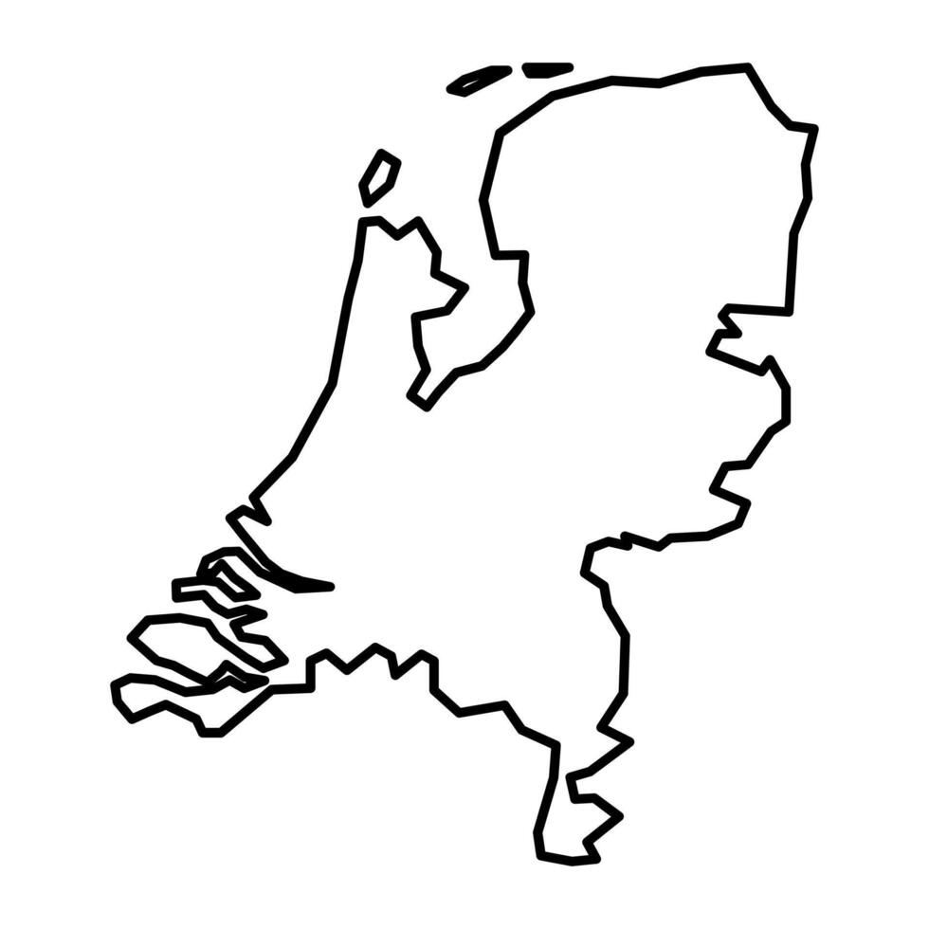
Case Studies
The Netherlands (Agriport A7)
F&B Facility: Horticulture (Greenhouses)
01
Facility Info
Distance to data center: 1.0 km
Data center output temperature: 55°C
Facility use temperature: 55°C
Financials
CAPEX: N/A
Payback period: N/A
Carbon tax: €74 / ton CO₂
Subsidies Available
The SDE++ subsidy is a significant opportunity, offering up to €400 / ton CO₂ for waste heat projects.
Key Characteristics
This case assumes that due to the current Dutch taxation system, the heat would be given away rather than sold.
This is a unique case of industrial symbiosis, where data center heat is supplied to nearby greenhouses.
The optimal temperature is a blend of waste streams to achieve 55°C, avoiding the need for heat pumps and preventing wasteful use of high-grade heat.
The business case here is driven less by direct profit and more about sustainability, community relations, and securing building permits for future expansion.

Slide 19

Case Studies
Spain (Zaragoza)
F&B Facility: La Zaragozana (Brewery)
01
Facility Info
Distance to data center: 3.0 km
Data center output temperature: 30°C
Facility use temperature: 80°C
Financials
CAPEX: €4.4M
Payback period: 4.3 years
Carbon tax: €73 / ton CO₂
Subsidies Available
The IDAE provides CAPEX subsidies of up to 50% for large-scale industrial heat pumps (35% for the pump, 15% for installation).
Key Characteristics
Zaragoza is an emerging data center hub with a strong F&B sector.
Partnering with an iconic, recognizable brand like La Zaragozana offers significant public relations value.
There is a promising future opportunity with the planned CLAVE agri-food tech zone and the massive Costa Group meat complex.

Slide 20

Case Studies
Sweden (Staffanstorp)
F&B Facility: Oatly (Oat Milk Production)
01
Facility Info
Distance to data center: 30 km
Data center output temperature: 30°C
Facility use temperature: 75°C
Financials
CAPEX: [BLANK]
Payback period: [BLANK]
Carbon tax: 0
Subsidies Available
CAPEX support is available from the Swedish Energy Agency and EU programs. Additionally, the local municipality of Staffanstorp offers free energy and climate advisory services to help navigate funding options.
Key Characteristics
This extremely long distance (30 km) pushes the boundaries of what is typically considered for heat reuse.
The partnership with a highly sustainability-focused global brand aligns with with Microsoft's CSR goals.
Because Sweden already uses waste heat, biofuels, and electricity for their heat needs, this case assumes data center heat would not offset gas use.

Slide 21

Thank You
Contact:
David Gardiner (david@dgardiner.com)
Petter Terenius (petterterenius@gmail.com)

